Slide 1
MET CS 673 Professor Yuting Zhang
Inner Circle
Iteration 1
MET CS 673 Professor Yuting Zhang
Team 1 : Wasupol, Peter, Ananya, Michael, Raef, Jian

Slide 2

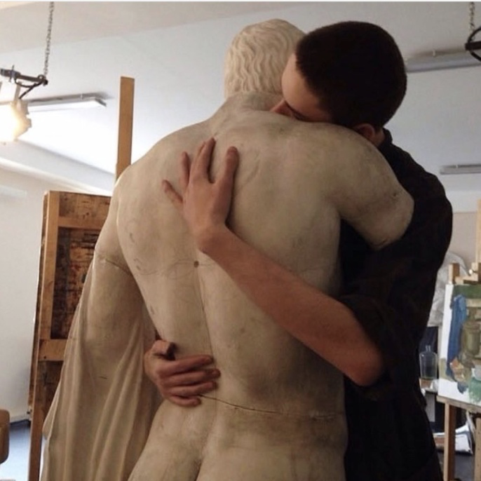
Project Overview
With so many social media and applications,
We still long for intimacy, privacy, and communication with our inner circles such as our close friends and loved ones.
We share our readings, music, opinions, and daily stories freely, We feel the same feel of our close ones, we feel that we are connected.
Here, we are a concrete person instead of a mixture of tags, titles, or fancy pictures.
Target audience: high school and college students, urban youth, and young professionals...
Notes:
Jian Ma - speaking
Storyboard?

Slide 3
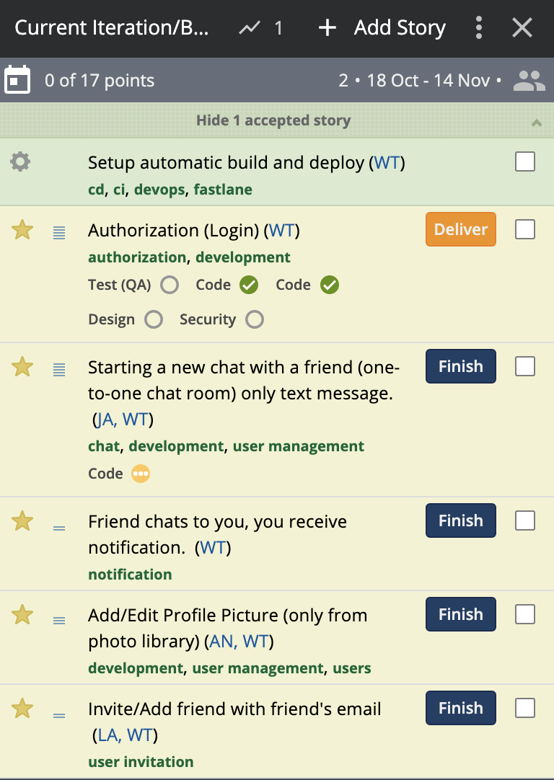
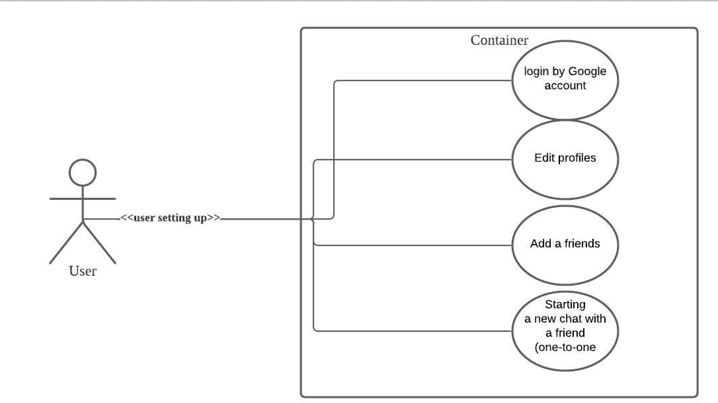
Requirements Analysis

Slide 4
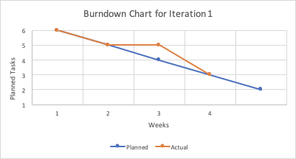
Iteration 1 Burndown Chart

Slide 5


System Architecture (Current)
Firebase Authentication
UI libraries to authenticate users to application (Google Login, etc.)
Firebase Cloud Firestore
Database from Google Cloud Platform that provides ability to have real time services for mobile development
Real-time Data Updates
Real time data synchronization for connected applications
Android Mobile Users

Slide 6
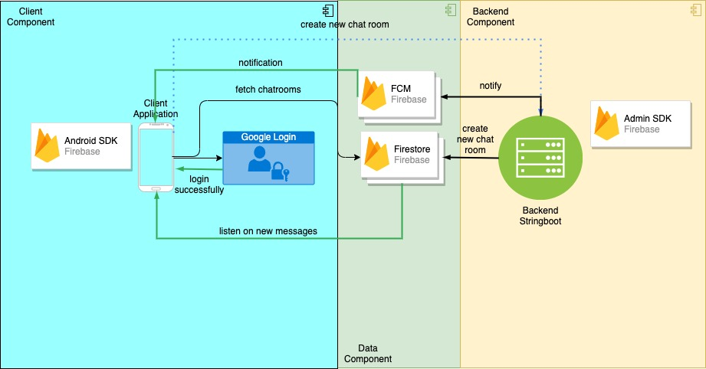
System Architecture (Proposed)

Slide 7
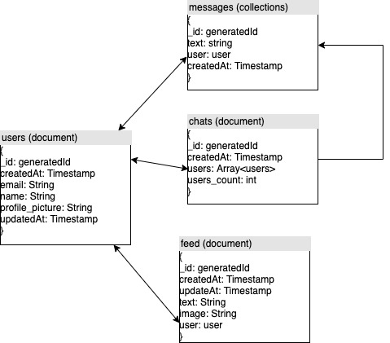
Data Design (noSQL document type)

Slide 8
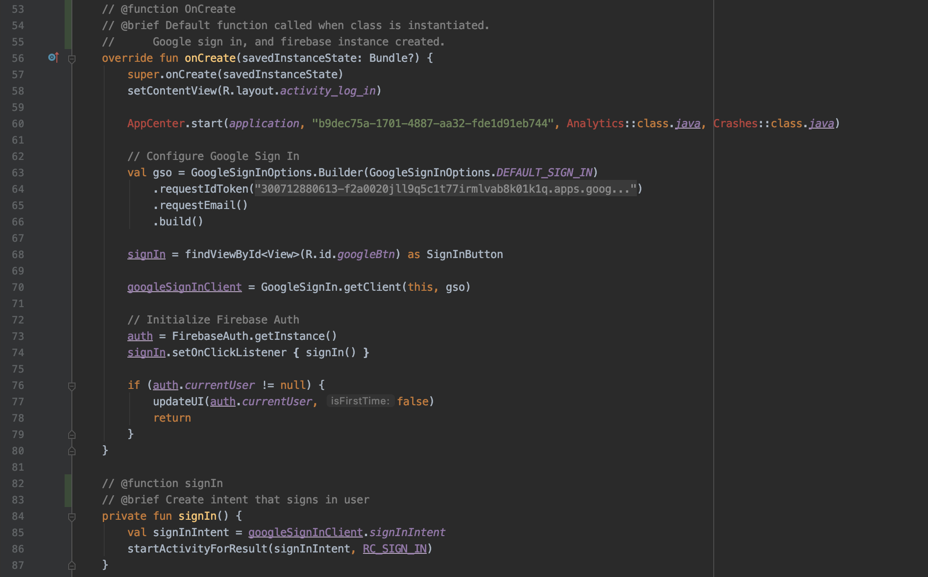
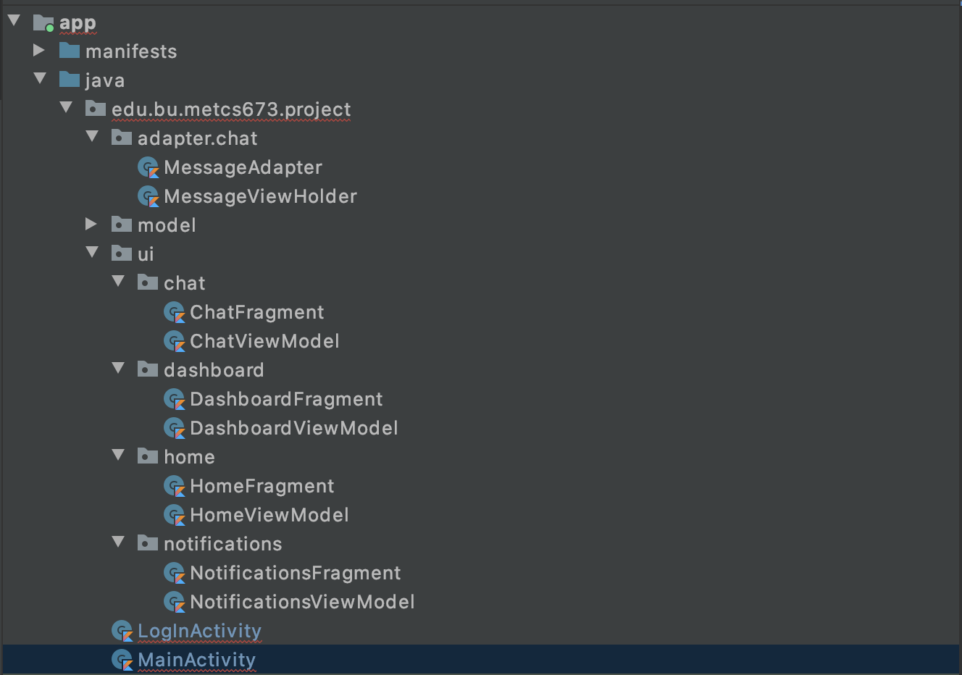
Implementation
Code Structure
Kotlin class implementation for each application requirement
Required documentation comments for classes and functions
Comment Documentation Example
Class Implementation Example

Slide 9
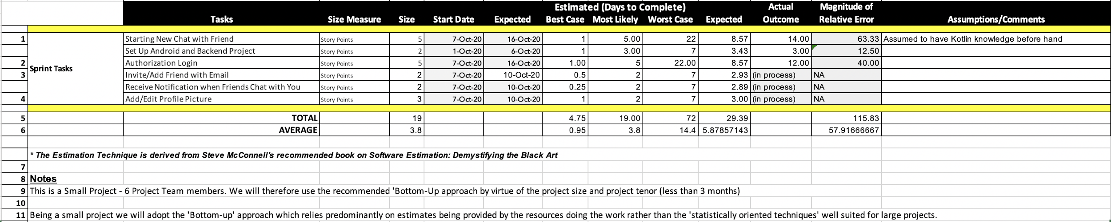
Project Management: Estimation

Slide 10
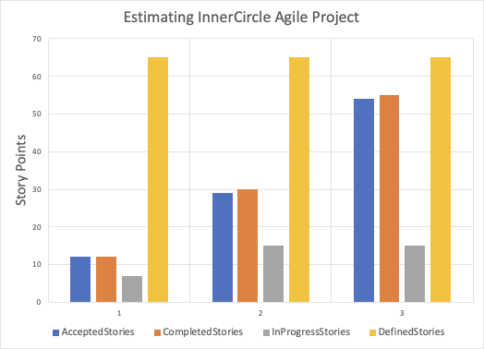
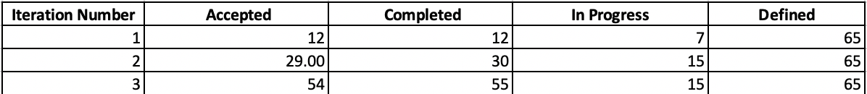
Project Management: Estimating Iterations
Notes:
Calculated team velocity for this iteration was ~.5points/day
Assuming team velocity to be constant (which it probably won’t be, as we will improve team velocity), we expect ~ 10 new points to be completed. However, since we have ~7points in progress from iteration 1, it is projected we have those completed and added into accepted stores for iteration 2. Thus, for iteration 2, we will have a total of 10 points + 7 points (from the “in progress” portion of previous iteration). Same idea applies for iteration 3.

Slide 11
Lessons Learned: Iteration 1
Improve estimation metrics for each sprint requirement
User stories can be broken down into separate components
Account for overhead in learning Android development material
Team Member Communication.
Due to the lack of physical presence, we strive to improve manners to communicate with one another as efficiently as possible
Deal with time differences: recording meetings if important.

